Slide 1
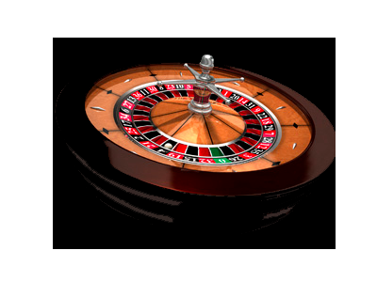
РУЛЕТКА
Направена от
Виктор Цонев
Васил Какевски
Петър Ефтимов
Росица Маджарова

Slide 2
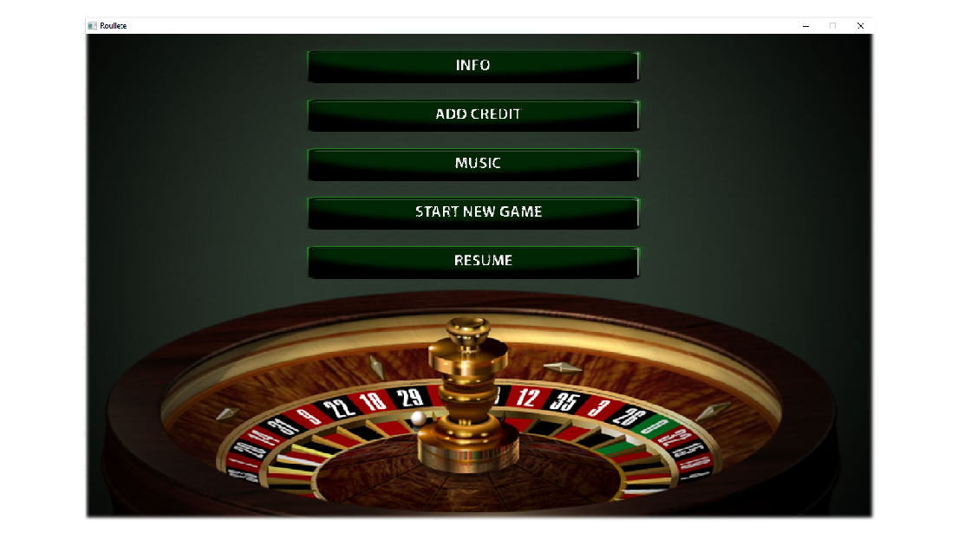
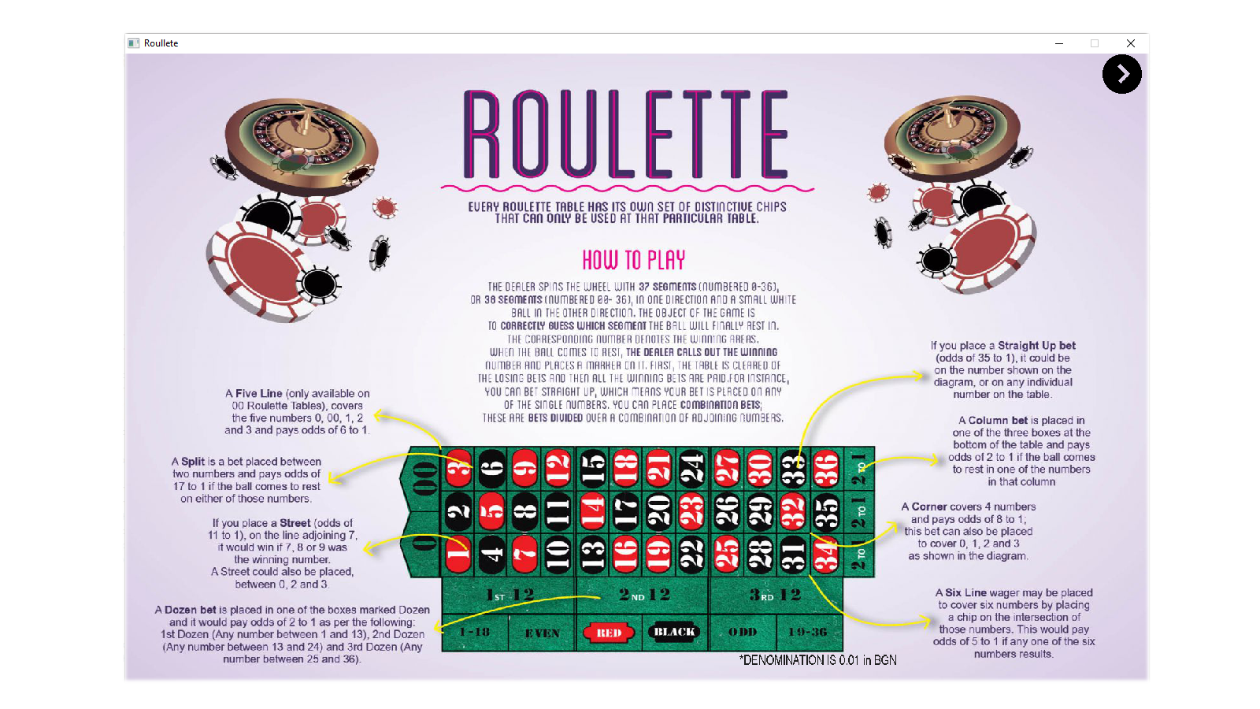
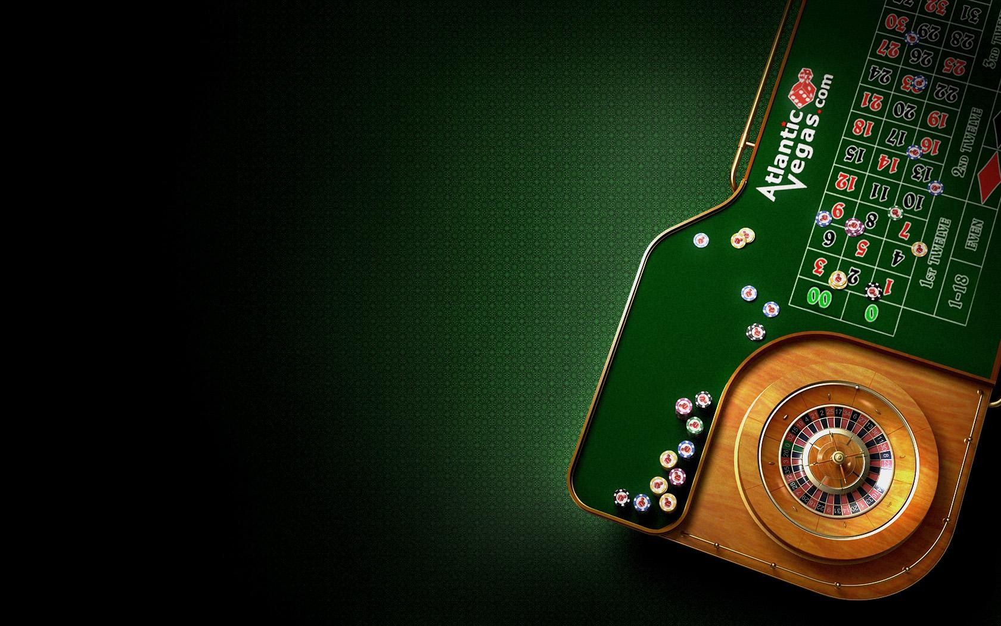
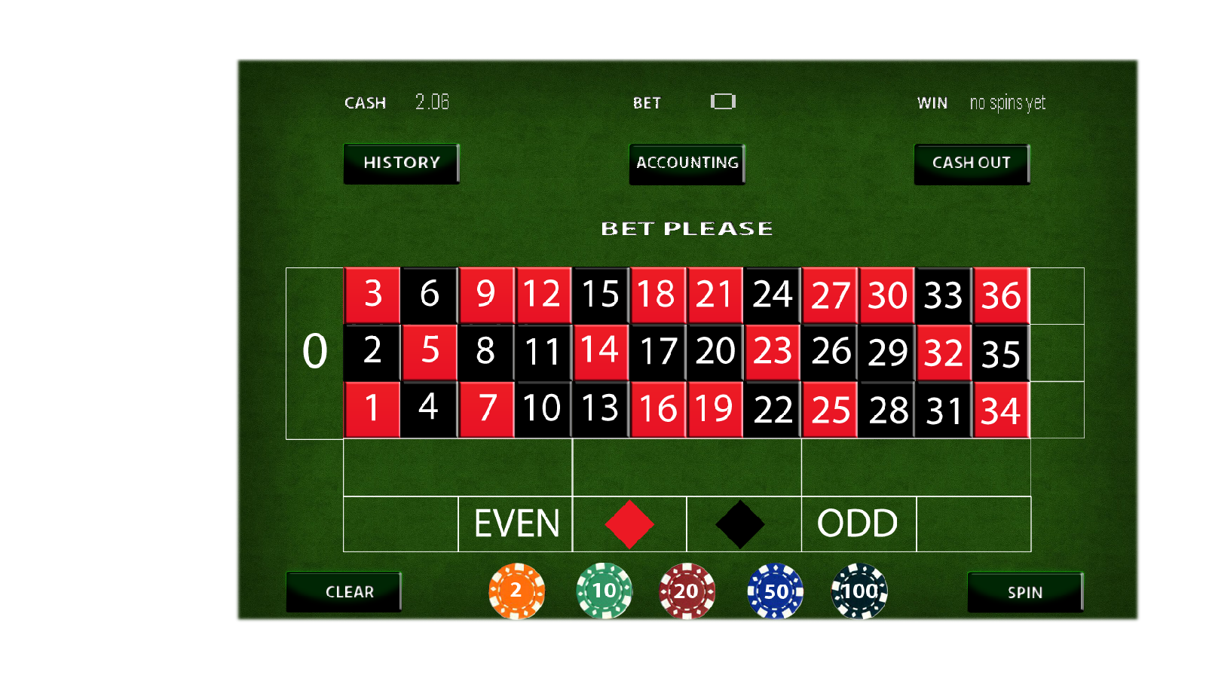
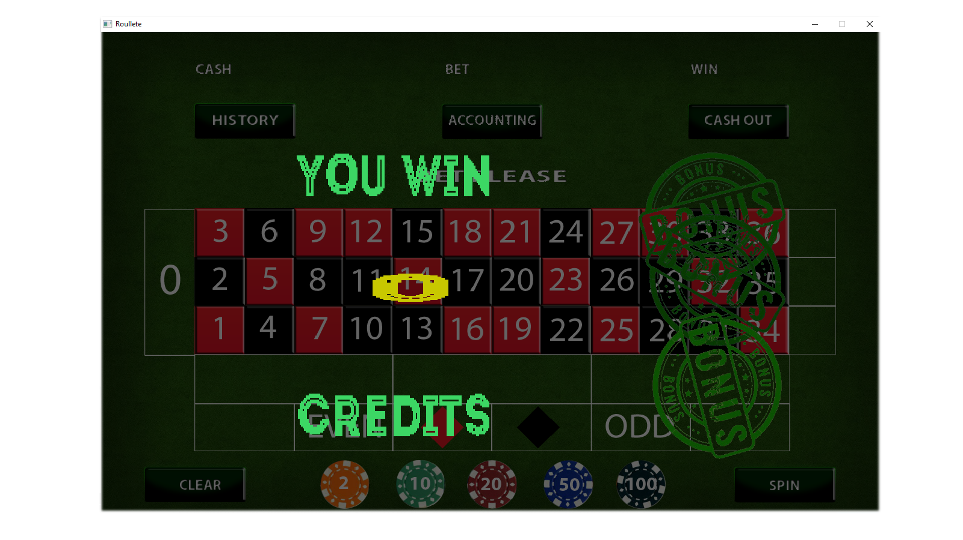
ЕКРАНИ
Основните екрани в играта са Интро, Инфо, Игра, Печалба, Изходен и Бонус.
Основни екрани в играта
Интро
Инфо
Игра
Печалба
Изходен
Бонус

Slide 3
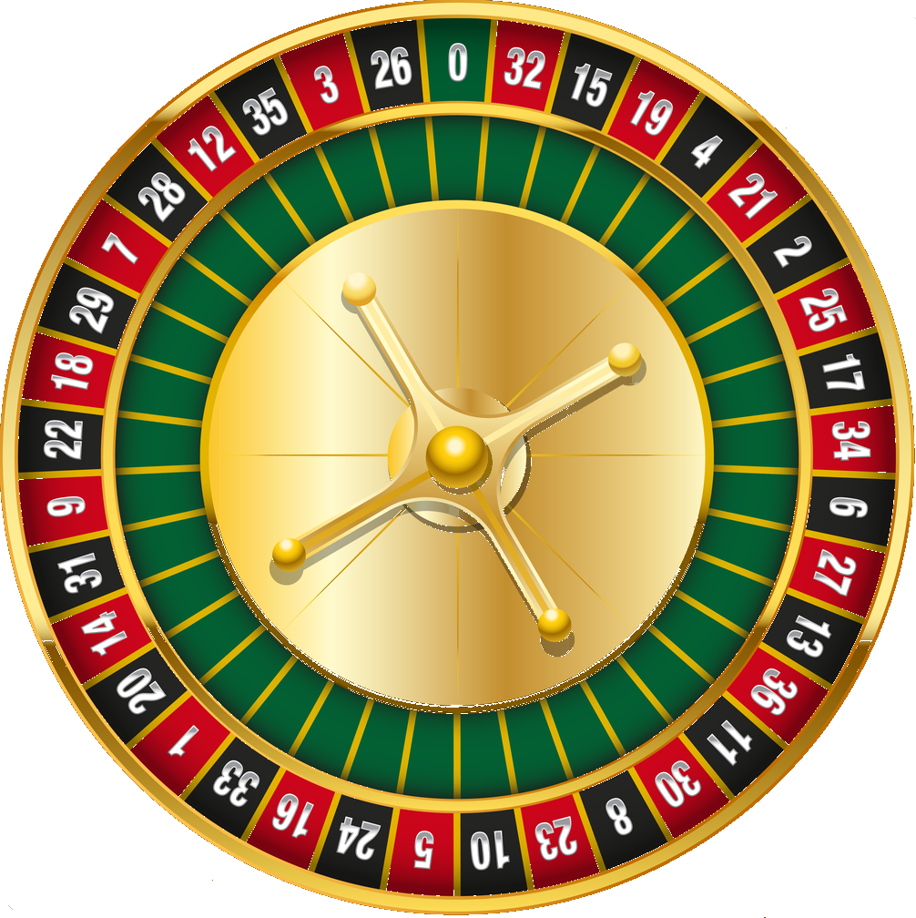
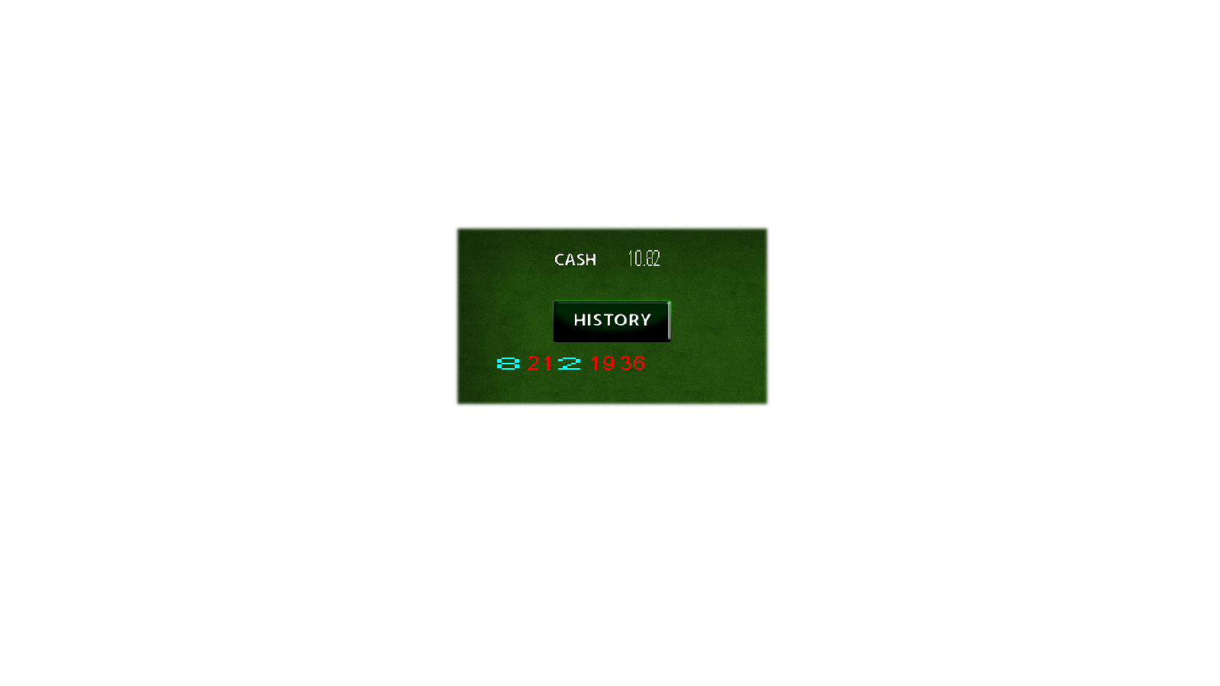
ЕКРАНИ
Допълнителни екрани
Въртяща се рулетка
История
Счетоводство

Slide 4
ИНТРО
БУТОНИ:
Инфо
Добави кредити
Музика
Старт
Зареди игра

Slide 5
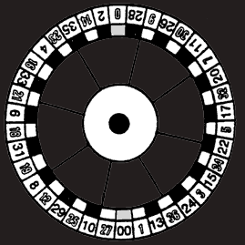
class IntroScreen
class IntroScreen
{
public:
IntroScreen();
virtual ~IntroScreen();
bool Draw();
bool Clear();
bool getFlag(){return isActive;}
void IntroScreenShowCredits(Credits& credits);
public:
LTexture* introBackground;
Button* introButtons[INTRO_BUTTONS];
//bool for mouseEvents
bool isActive;
};

Slide 6
class IntroScreen
void IntroScreen::IntroScreenShowCredits(Credits& credits)
{
Clear();
Draw();
if (credits.GetCredit())
{
Text textCredit(SCREEN_W / 2 - 500 / 2 + 50 + 470,
SCREEN_H / 10 - INTRO_BUTTONS_H / 2
+ (INTRO_BUTTONS_H + 10)
, 230, 40, 20, "Credits: ", { 100,
200, 100, 255 });
Text textCreditsNumber(
SCREEN_W / 2 - 500 / 2 + 50 + 690,
SCREEN_H / 10 - INTRO_BUTTONS_H / 2
+ (INTRO_BUTTONS_H + 10)
, 60, 40, 20, credits.GetCredit(),
{ 100, 200, 100 });
}
}

Slide 7
ИНФО
Този екран има само един бутон за Изход

Slide 8
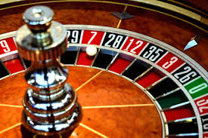
class InfoScreen
class InfoScreen
{
public:
InfoScreen();
virtual ~InfoScreen();
bool Draw();
bool Clear();
bool getFlag(){return isActive;}
public:
LTexture* infoBackground;
Button* infoBack;
bool isActive;
};

Slide 9
ИГРАЛЕН ЕКРАН
БУТОНИ:
Завърти рулетката
Изчисти залозите
Изтегли пари
Последните 18 сектора
Счетоводство

Slide 10
class GameBoard
class GameBoard
{
public:
GameBoard();
virtual ~GameBoard();
bool Draw();
bool Clear();
bool getFlag(){return isActive;}
void DisplayStatistics(Credits* credits , int lastWinningNumber);
int CalcQuadrandClicked(int x, int y);
void DisplayBets(Credits* credits , int x, int y, int color,
bool resume = false);
public:
LTexture* gameBoard;
Button* gameBoardPools[POOLS_BUTTON];
Button* cashOut;
Button* spin;
Button* history;
Button* accounting;
Button* clearBets;
Sound* sound;
bool isActive;
};

Slide 11
class GameBoard
if (coordX != -1 && coordY != -1)
{
if (credits->GetCredit() >= value[j]) //credits logic
{
Button gameBoardPools(coordX, coordY);
gameBoardPools.loadFromFile("Pools.png");
gameBoardPools.setWidth(POOLS_W);
gameBoardPools.setHeight(POOLS_H);
SDL_Rect rec = { j * 111 + 5, 1, 111, 110 };
gameBoardPools.render(&rec, 0, NULL, SDL_FLIP_NONE, 60, 60);
//while piece to write on
LTexture overPullUnderText(coordX + 17, coordY + 17);
overPullUnderText.loadFromFile("BALL.png");
overPullUnderText.setWidth(POOLS_W);
overPullUnderText.setHeight(POOLS_H);
overPullUnderText.render(NULL, 0, NULL, SDL_FLIP_NONE,
POOLS_W / 3, POOLS_H / 3);
sound->play(CLICKBUTTON);
if (!resume)
{
credits->AddBet(value[j]);
credits->ChangeCredits(-value[j]);
credits->betByNumberCell[clickedCell] += value[j];
}
Text textInPool(coordX + 20, coordY + 22, POOLS_W / 2 + 8,
POOLS_H / 2 + 8, 15,
credits->betByNumberCell[clickedCell]
, { 0, 0, 0, 255 }, "Intro.otf");
Text textBet(SCREEN_BOARD_W / 2 + 25, 40, 45, 35, 15,
credits->GetBet(),
{ 200, 200, 200, 255 });
recovery->appendToXML(credits->betByNumberCell);
recovery->appendToXMLCredits(credits->GetCredit(),
credits->GetBet(), credits->GetCreditsCollected());
} //end credits
}

Slide 12
class GameBoard
GameBoard::~GameBoard()
{
for (int i = 0; i < POOLS_BUTTON; i++)
{
delete gameBoardPools[i];
}
cashOut->free();
delete cashOut;
spin->free();
delete spin;
history->free();
delete history;
accounting->free();
delete accounting;
clearBets->free();
delete clearBets;
delete sound;
}
bool GameBoard::Draw()
{
background->render(NULL, 0, NULL);
isActive = true;
return true;
}
bool GameBoard::Clear()
{
SDL_RenderClear(LWindow::gRenderer);
isActive = false;
return true;
}

Slide 13
ИЗХОДЕН ЕКРАН
Без бутони
6 секунди презентиране

Slide 14
class OutroScreen
OutroScreen::OutroScreen()
: Screen()
{
background->loadFromFile("OutroScreen2.jpg");
background->setWidth(SCREEN_W);
background->setHeight(SCREEN_H);
isActive = false;
}
OutroScreen::~OutroScreen()
{
}
class OutroScreen: public Screen
{
public:
OutroScreen();
virtual ~OutroScreen();
bool Draw();
bool Clear();
void Show(Credits* credits);
};

Slide 15
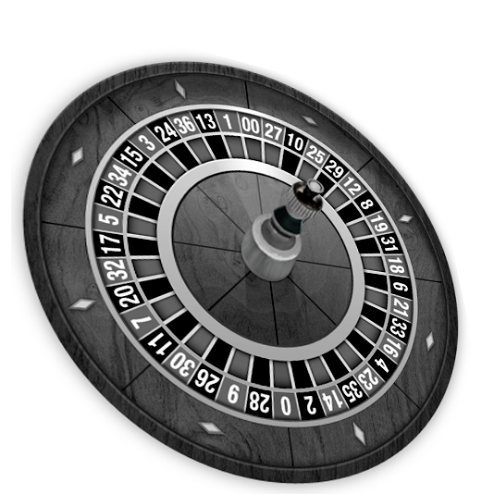
class OutroScreen
void OutroScreen::Show(Credits* credits)
{
double scale = 0.6;
Text textMoneyNumber((SCREEN_W / 8 + 520) * scale, 400 * scale, 180 * scale,
200 * scale, 15, credits->GetCredit() * DENOMINATION, { 200, 10, 10,
255 });
cout << credits->GetCredit() << "bbbb" << endl;
}
bool OutroScreen::Clear()
{
SDL_RenderClear(LWindow::gRenderer);
isActive = false;
return isActive;
}

Slide 16
БОНУС ЕКРАН
Без бутони
3 секунди презентиране
анимация с
бонус
печати.

Slide 17
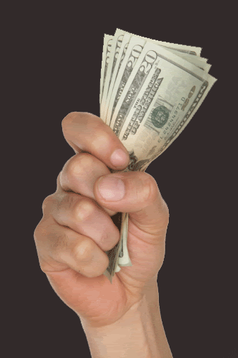
class BonusScreen
class BonusScreen: public Screen
{
public:
BonusScreen();
virtual ~BonusScreen();
bool Draw();
bool Clear();
bool getBonusCreditsText(Credits*);
public:
LTexture* bonusSticker;
Sound* sound;
};

Slide 18
class BonusScreen
Text textYouWin(SCREEN_W / 4, SCREEN_H / 4, SCREEN_W / 4,
SCREEN_H / 8, 30, "You Win", col, "Intro Inline.otf");
Text textCredits(SCREEN_W / 4, SCREEN_H * 3 / 4,
SCREEN_W / 4, SCREEN_H / 8,
30, "credits", col, "Intro Inline.otf");
for (int i = 0; i < 3; i++)
{
SDL_SetTextureColorMod(bonusSticker->getTexture(),
rand() % 100 + 150, rand() % 70 + 70, rand() % 100 + 150);
bonusSticker->setY((i + 1) * SCREEN_H / 6 + rand() % 50);
bonusSticker->render(NULL, i * 45, NULL);
SDL_Delay(500);
}
isActive = false;
return true;
}
bool BonusScreen::Draw()
{
background->render(NULL, 0, NULL);
SDL_Delay(2000);
sound->play(WIN);
srand(time(0));
SDL_Color col = {
rand() % 200 + 50,
rand() % 200 + 50,
rand() % 200 + 50,
255 };

Slide 19
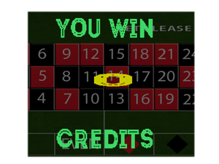
class BonusScreen
bool BonusScreen::getBonusCreditsText(Credits* credits)
{
srand(time(0));
Text textWinnings(SCREEN_W / 3,
SCREEN_H * 2 / 4,
SCREEN_W / 8, SCREEN_H / 12, 40,
credits->GetCreditsCollected(),
{ 200, 200, 0 }, "Intro Inline.otf");
SDL_Delay(1500);
return true;
}

Slide 20
ВЪРТЯЩА СЕ РУЛЕТКА
Допълнителен екран включващ анимация на въртящо се колело с топче

Slide 21
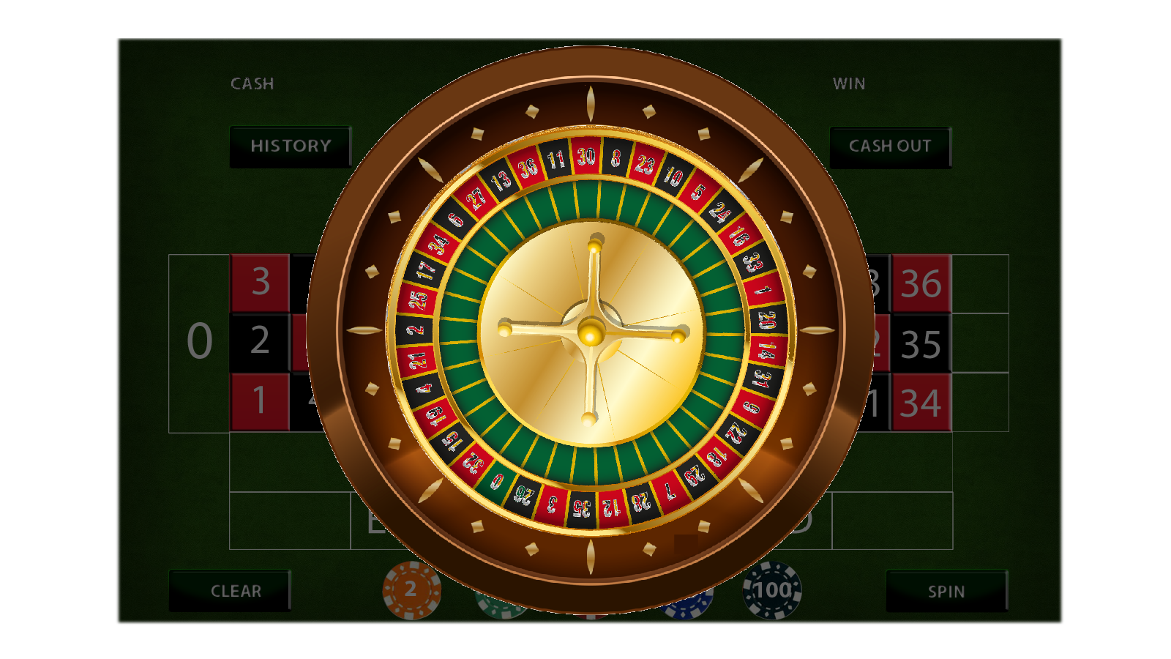
class SpinScreen
class SpinScreen: public Screen
{
public:
SpinScreen();
virtual ~SpinScreen();
bool Draw();
bool Clear();
int GenerateWinningNumber();
int GetWinningNumber();
bool IsReadyForBonus();
private:
LTexture* roulette;
LTexture* wheel;
LTexture* ball;
Sound* sound;
private:
int numberOfSpins;
int winningNumber;
void FillTheMapsOfRoulette();
};

Slide 22
bool SpinScreen::Draw() {
int result = GenerateWinningNumber();
background->render(NULL, 0, NULL);
sound->play(SPINROULETTE);
SDL_Delay(2000);
int mFrame = 0;
double angleWheel = -3 + 9.7 * (posissionToNumberInRoulette[result] - 5);
double stepWheel = 2;
double maxR = 310, minR = 210,
currentR = maxR, minAngle = -95,
step = M_PI / 36, angleBall = 0;
do {
angleBall -= (maxR - currentR) / (12 * 200.0 / M_PI);
currentR -= (maxR - minR) / (10 * 200.0 / M_PI);
angleBall -= step;
ball->setX(SCREEN_W / 2 - BALL_W / 2 + cos(angleBall) * maxR);
ball->setY(SCREEN_H / 2 - BALL_H / 2 + sin(angleBall) * maxR);
if (mFrame % 3 == 0)
{
roulette->render(NULL, 0);
wheel->render( NULL, angleWheel);
ball->render( NULL, 0);
}
angleWheel += stepWheel;
maxR -= 0.1;
mFrame++;
}
while (angleBall > minAngle);
sound->play(WINING_NUMBER);
SDL_Delay(2000);
sound->music(result);
SDL_Delay(1000);
numberOfSpins++;
return true;
}

Slide 23
ИСТОРИЯ
Допълнителен екран
показващ последните
18 печеливши числа.

Slide 24
СЧЕТОВОДСТВО
Допълнителен
екран показващ
статистики от
играта.

Slide 25
ЕКРАН ПРИ ПЕЧАЛБА
Допълнителен екран без бутони
6 секунди презентиране
анимация с
въртящи се
монети

Slide 26
class WinScreen
class WinScreen: public Screen
{
public:
WinScreen();
virtual ~WinScreen();
bool Draw();
bool Clear();
void WinAnimation();
void ShowCredits(Credits*);
private:
void fillRectPosition();
LTexture* coin[COIN_COUNT];
};
void WinScreen::ShowCredits(Credits* credits)
{
WinAnimation();
SDL_Color color { rand() % 255, rand() % 255, rand() % 255, rand() % 255 };
Text winAmmount(SCREEN_W / 2 - 300 / 2, SCREEN_H * 3 / 5,
300, 100, 20, credits->GetWinProfit(), color);
SDL_Delay(1000);
}

Slide 27
class WinScreen
void WinScreen::WinAnimation()
{
vector<SDL_Rect> goldCoins;
for (int i = 0; i < 10; i++)
goldCoins.push_back(
{ COIN_W * i, 0, COIN_W, COIN_H });
for (int i = 0; i < (int) coinFlipz.size(); i++) {
coin[i]->setX(coinFlipz[i].x);
coin[i]->setY(coinFlipz[i].y);
SDL_Color color { rand() % 255, rand() % 255, rand() % 255, rand() % 255 };
Text winText(SCREEN_W / 2 - 300 / 2, SCREEN_H / 2 - 10/2,
300, 100, 20, "YOU WIN", color);
for (int j = 0; j < 10; j++) {
SDL_RenderCopyEx(LWindow::gRenderer, coin[i]->getTexture(),
&goldCoins[j], &coinFlipz[i], -90, NULL, SDL_FLIP_NONE);
SDL_RenderPresent(LWindow::gRenderer);
SDL_Delay(5);
} } }
void WinScreen::ShowCredits(Credits* credits)
{
WinAnimation();
SDL_Color color { rand() % 255, rand() % 255, rand() % 255, rand() % 255 };
Text winAmmount(SCREEN_W / 2 - 300 / 2, SCREEN_H * 3 / 5,
300, 100, 20, credits->GetWinProfit(), color);
SDL_Delay(1000);
}

Slide 28
void WinScreen::fillRectPosition()
{
SDL_Rect rec = { 20, 675, 90, 90 };
coinFlipz.push_back(rec);
rec.x = 128;
rec.y = 690;
rec.w = 95;
rec.h = 95;
coinFlipz.push_back(rec);
rec.x = 230;
rec.y = 650;
coinFlipz.push_back(rec);
rec.x = 358;
rec.y = 580;
coinFlipz.push_back(rec);
rec.x = 485;
rec.y = 650;
rec.w = 105;
rec.h = 105;
coinFlipz.push_back(rec);
rec.x = 270;
rec.y = 445;
rec.w = 95;
rec.h = 95;
coinFlipz.push_back(rec);
rec.x = 340; rec.y = 490;
rec.w = 90; rec.h = 90;
coinFlipz.push_back(rec);
rec.x = 200; rec.y = 575;
rec.w = 75; rec.h = 75;
coinFlipz.push_back(rec);
rec.x = 120; rec.y = 635;
rec.w = 65; rec.h = 65;
coinFlipz.push_back(rec);
for (int i = 0; i < 9; i++){
rec = coinFlipz[i];
rec.x = SCREEN_W - rec.x - rec.w + 15;
coinFlipz.push_back(rec); } }

Slide 29

ВЪЗСТАНОВЯВАНЕ НА ИГРАТА
При натискане на бутон RESUME в началният екран
играта се възстановява до момента на прекъсване.
Възстановяването се реализира с помощта на XML файлове.

Slide 30
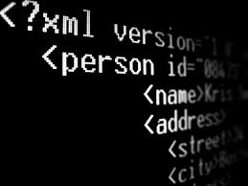
if (intro.introButtons[4]->isClicked(&e))
{
intro.sound->play(CLICKBUTTON);
intro.Clear();
if (game.Draw())
{
credits = recovery.readXMLWriteCredit(
"roulette_recovery_credits.xml");
credits.betByNumberCell = recovery.readXMLWriteMap(
"roulette_recovery.xml");
game.DisplayStatistics(&credits,
recovery.lastWiningNumbers.back());
for (int y = 285; y < SCREEN_BOARD_H; y += 75)
for (int x = 77;
x < SCREEN_BOARD_W - 77; x += 75)
{
if (y > 550)
x += 75;
if (credits.betByNumberCell[
game.CalcQuadrandClicked(x, y)] > 0)
game.DisplayBets(&credits, x, y, 1,
true, &recovery);
}
}
}

Slide 31
ДЕМО

Slide 32
БЛАГОДАРИМ ЗА ВНИМАНИЕТО

